Slide 1
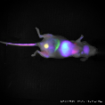
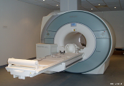
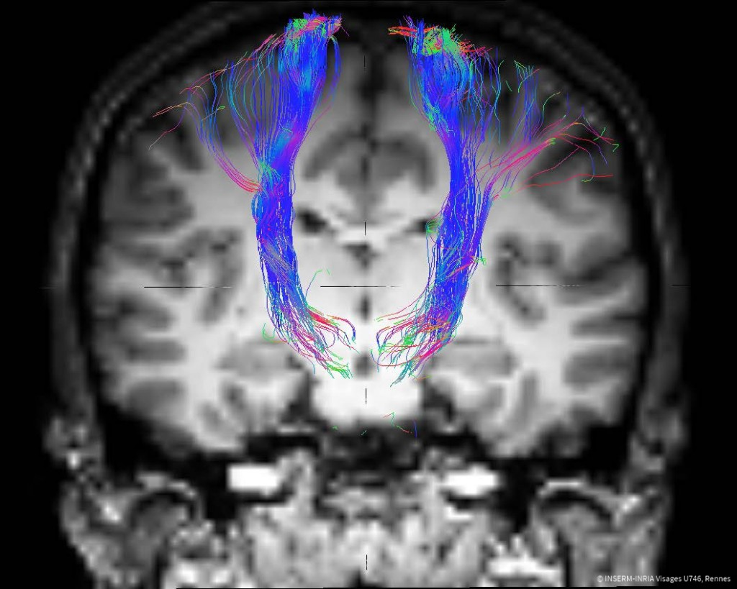
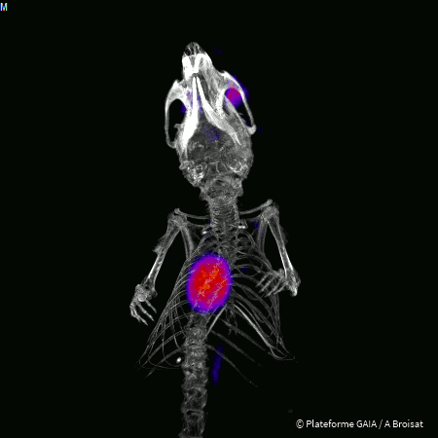
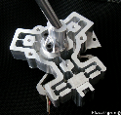
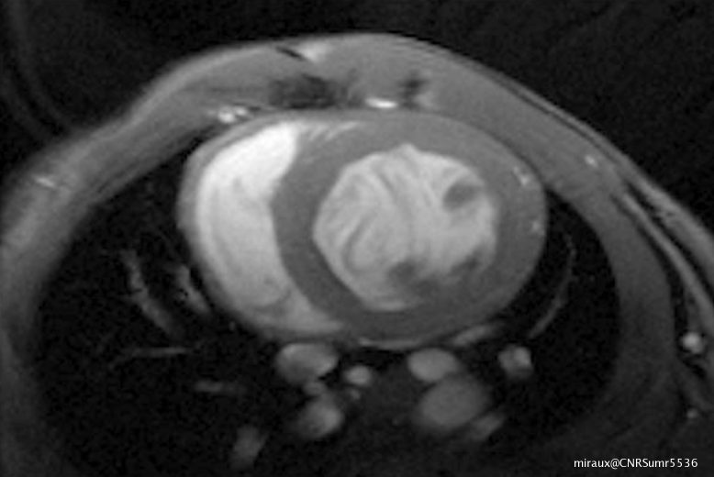
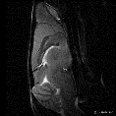
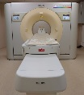
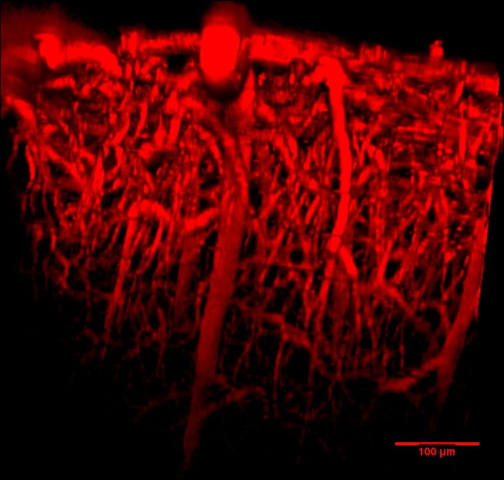
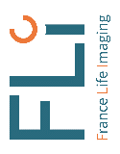

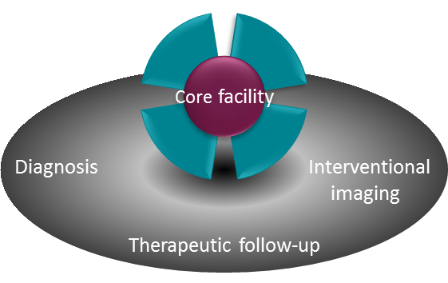
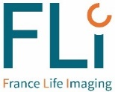

France Life Imaging, your access to the French biomedical imaging research
Gathering under its banner the French network of academic biomedical imaging research, France Life Imaging has become the essential point of access to this field.
Thanks to a thorough knowledge of the biomedical imaging research environment, the involvement of experts and key opinion leaders and a comprehensive perspective of the sector, FLI helps its partners build the most relevant answer to their needs.
A comprehensive service offer in
in-vivo imaging to answer your needs
R&D services Training
Collaboration Expertise
Your needs
FLI
Thematic networks
Our offer
Laboratories
Facilities
FLI positioning within the clinical research continuum
Clinical research with standard imaging techniques
Clinical research with advanced imaging techniques
Methodology developments in biomedical imaging
Preclinical research
http://www.francelifeimaging.fr

Slide 2
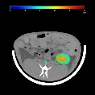
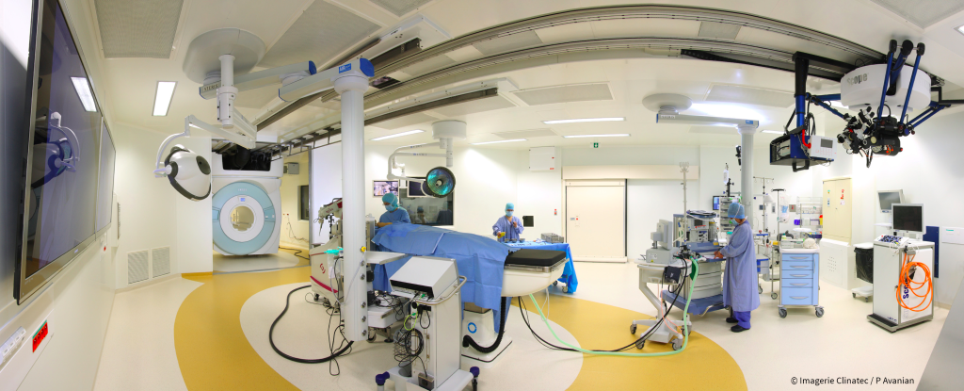
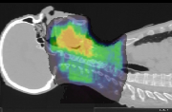
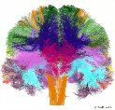
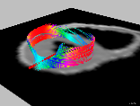
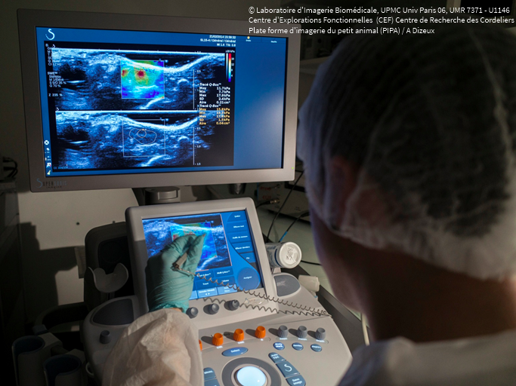
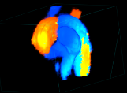
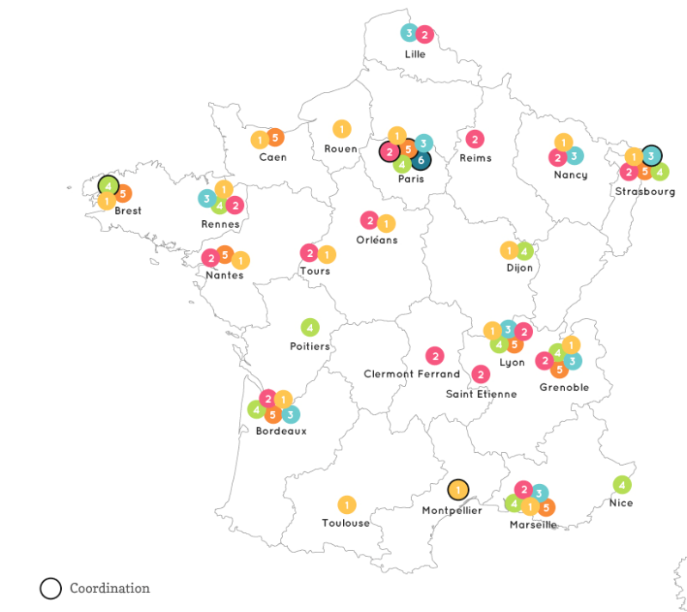

France Life Imaging, your access to the French biomedical imaging research
Cardiology – Metabolism
Oncology – Neurology
Therapeutic areas
Engineering
Instrumentation and detectors
Modelling – MRI sequences
Grounded in a consistent fleet of preclinical and clinical equipment backed by strong and multidisciplinary scientific and clinical expertise, FLI provides the academic, clinical and industrial communities with a full range of tailor-made services.
The FLI offer is built on a privileged access to the technologies and facilities, a support in setting up and developing projects and partnerships with the research teams, and training programs on the different aspects of biomedical imaging.
Treatment - Analysis
Storage
Data and images
Chemistry
Contrast agents – Radiochemistry
vectorization and targeting
Core facility
Molecular imaging agents | Instrumentation and technological development
Interventional imaging | Quantitative multimodality image analysis
Training | Management
A cutting-edge equipment covering the whole range of biomedical imaging modalities
Clinical
Preclinical
A coordinated network of over 100 academic laboratories throughout France
MRI
Optical
Nuclear
MEG/EEG
X-rays
Others
Ultrasounds
Multimodal
http://www.francelifeimaging.fr

