Slide 1









France Life Imaging
A harmonized and coordinated network spanning the entire spectrum of biomedical imaging research

Slide 2
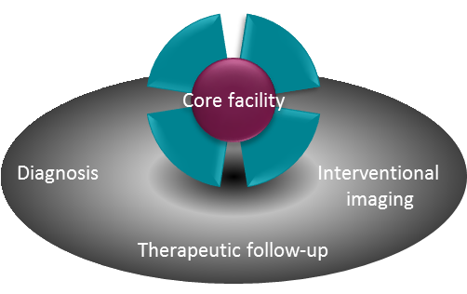
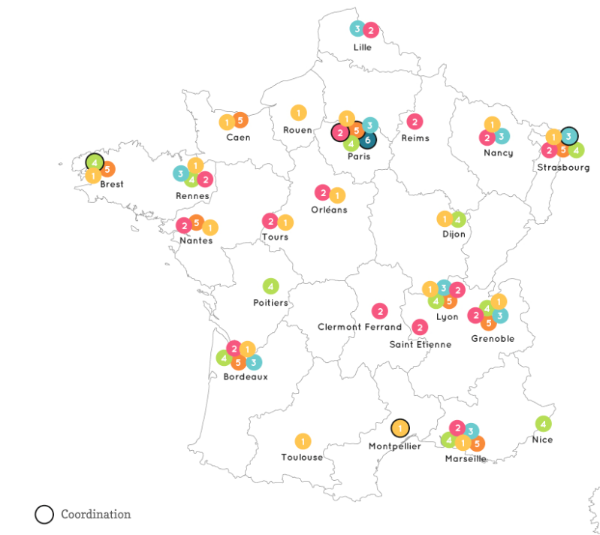

An infrastructure dedicated to the challenges and needs of biomedical imaging research
The key themes of the field comprehensively covered
A consistent fleet of cutting-edge equipment
Clinical
Preclinical
Molecular imaging agents | Technological development
Interventional imaging | Quantitative image analysis
Training | Management
MRI
X-rays
Optical
Others
Nuclear
MEG/EEG
Multimodal
Ultrasounds

Slide 3
An organisation centered on core facilities, hubs for biomedical imaging research
Gathering places for technologies and equipment
Meeting points for scientific, medical and technological expertise
Sites housing projects and teams, fostering partnerships and exchanges
Cardiology – Metabolism
Oncology – Neurology
Therapeutic areas
Engineering
Instrumentation and detectors
Modelling – MRI sequences
Treatment - Analysis
Storage
Data and images
Chemistry
Contrast agents – Radiochemistry
vectorization and targeting
Core facility

Slide 4








A translational approach built on a structural link with hospitals
A deep involvement in clinical research
A strong expertise on specific
therapeutic areas
  Neurology and neurosciences
  Oncology
  Cardiology and metabolism
Clinical research with standard imaging techniques
Clinical research with advanced imaging techniques
Methodology developments in biomedical imaging
Preclinical research

Slide 5
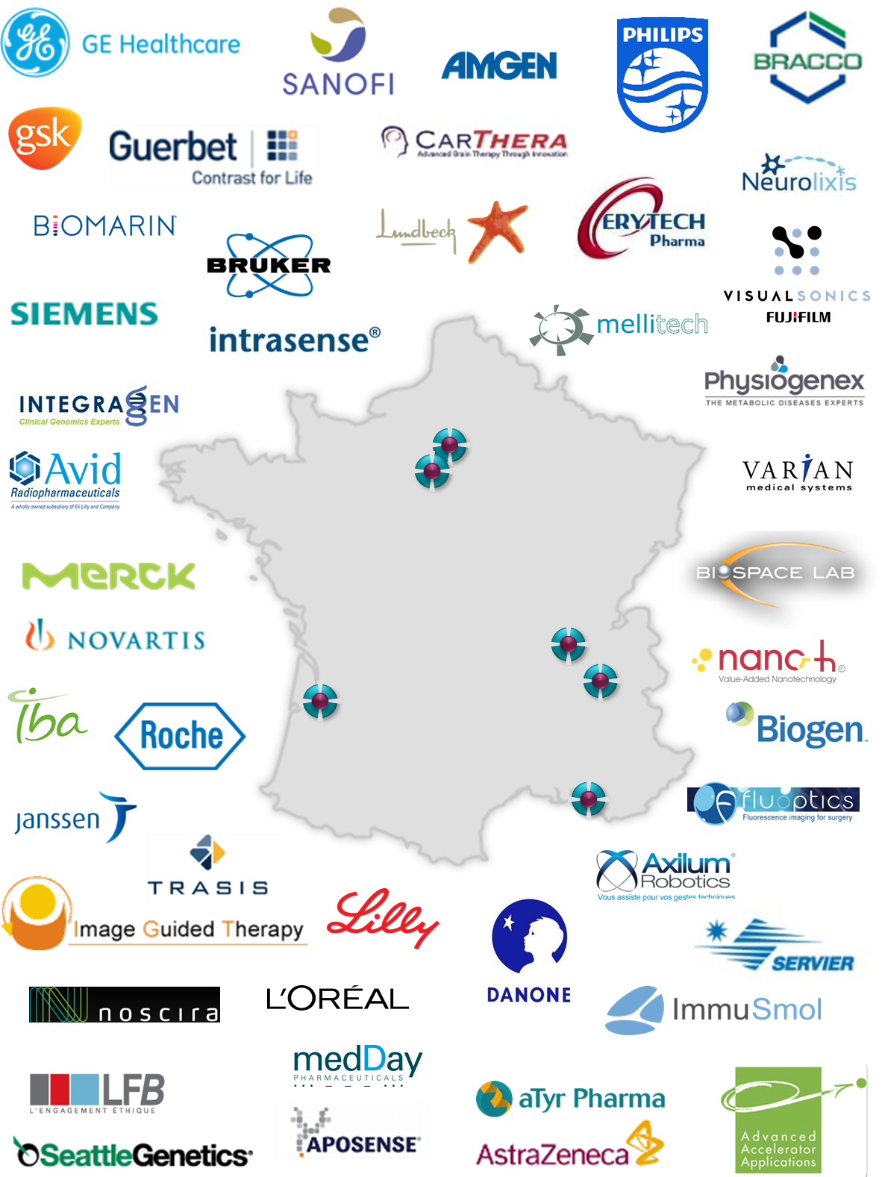
An expert contact point for collaborative research
Projects built in close relation with the teams running the core facilities
A flexible partnering strategy
  fee for research service,
  framework service agreement,
  collaborative programs, etc.
Quality management
Many industrial partnerships hosted within the FLI facilities

Slide 6

An easy access to the French resources and expertise of the biomedical imaging field
A privileged entry point to help you
find the best way to answer your needs
R&D services Training
Collaboration Expertise
Your needs
FLI
Thematic networks
Our offer
Laboratories
Facilities

Slide 7
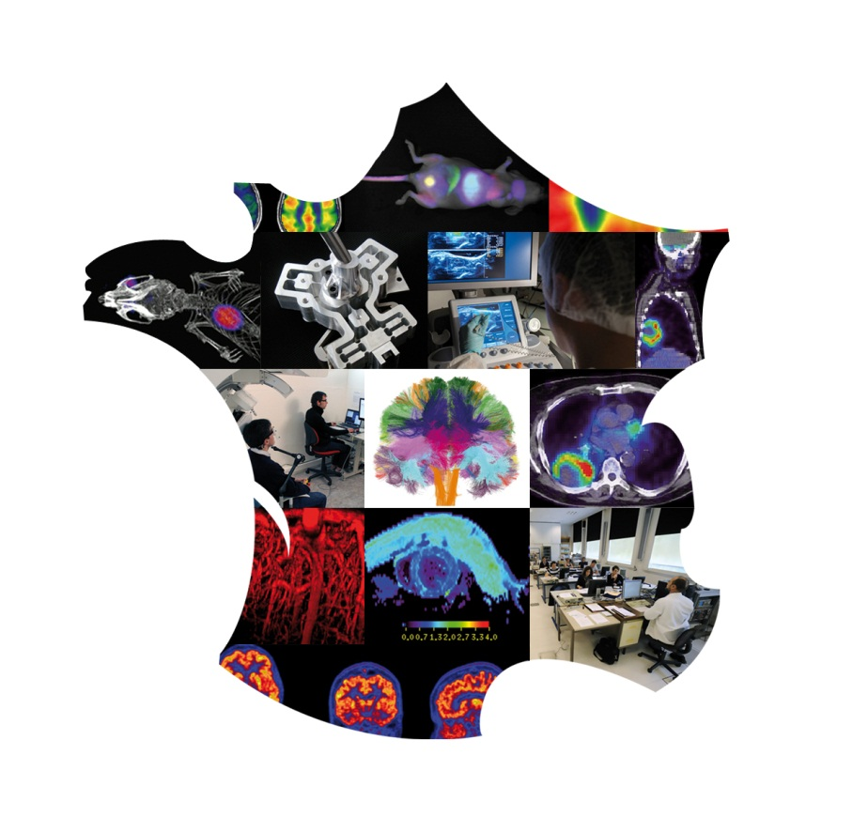
Thank you for your attention
Pierre Wiltz
Strategic marketing and business development
pierre.wiltz@cea.fr
www.francelifeimaging.fr

