Slide 1









France Life Imaging
A harmonized and coordinated network spanning the entire spectrum of biomedical imaging research

Slide 2
An organisation centered on core facilities, hubs for biomedical imaging research
Gathering places for technologies and equipment
Meeting points for scientific, medical and technological expertise
Sites housing projects and teams, fostering partnerships and exchanges
Cardiology – Metabolism
Oncology – Neurology
Therapeutic areas
Engineering
Instrumentation and detectors
Modelling – MRI sequences
Treatment - Analysis
Storage
Data and images
Chemistry
Contrast agents – Radiochemistry
vectorization and targeting
Core facility

Slide 3
A consistent fleet of preclinical and clinical equipment
FLI available equipment
Core facility
Diagnosis Interventional
imaging
Therapeutic follow-up
Clinical
Preclinical
Cutting edge equipment and prototypes
Clinical PET-MRI
Spectral scanner
PET-ultrasounds
Optoacoustics
Clinical EPR
Intra-vital imaging
MRI
Optical
Nuclear
X-rays
Others
MEG/EEG
Multimodal
Ultrasounds

Slide 4
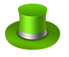

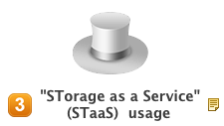
FLI-IAM, a network dedicated to information analysis and management
"Open Resource”
like service which provides housing of data (DaaS) and processing pipelines defined for the needs of a large (open) community of
users.
Platform as a Service (PaaS) "Open Resource" for professionals
Subcontracting
Service providing a
turnkey solution for the entire chain of quality control of resources (data / processing) from production to operation.
FLI-IAM Usage Scenarios
Software as a Service (SaaS) for clinical and preclinical distributed research
Resource service
Hosting-type services
(with backup) with libraries of processing pipelines defined for the specific needs of a distributed community.
Outsourced sharing resources for imaging data & processing (with backup) for human or animal in vivo imaging.
Storage and Computing as a Service (SCaaS)

Slide 5
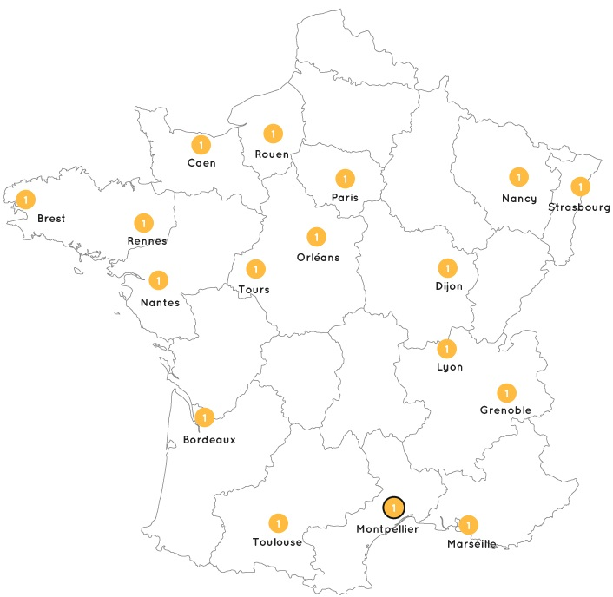
The key themes of the field comprehensively covered
Molecular imaging agents
Modular targeting platform for imaging
Probe and contrast agent development
Nanoparticles for imaging
Proof of concept, clinical applications, translational research

Slide 6
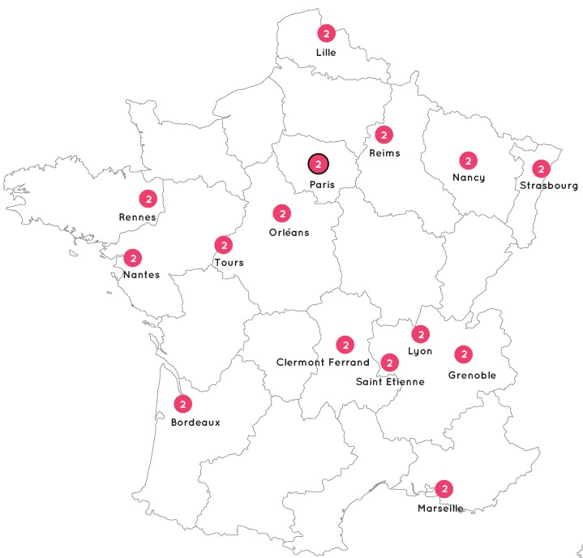
The key themes of the field comprehensively covered
Instrumentation and technological development
Magnetic resonance: integrated tools for unprecedented MRI sensitivity and contrast
Ultrasound imaging
Optical imaging
Ionizing radiation imaging: high resolution and high sensitivity detection systems
Multimodality and biomarkers

Slide 7
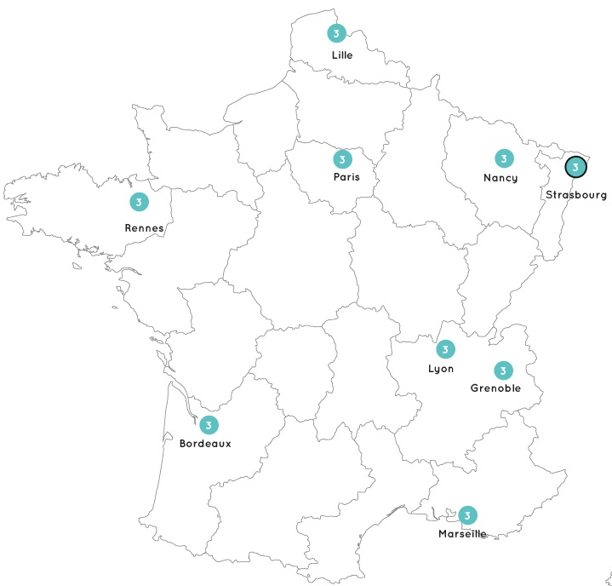
The key themes of the field comprehensively covered
Interventional imaging
Navigation and augmented reality
Robotized imaging systems
MR-guided interventions
Ultrasound-based therapies
Intra-operative imaging with dedicated small devices

Slide 8
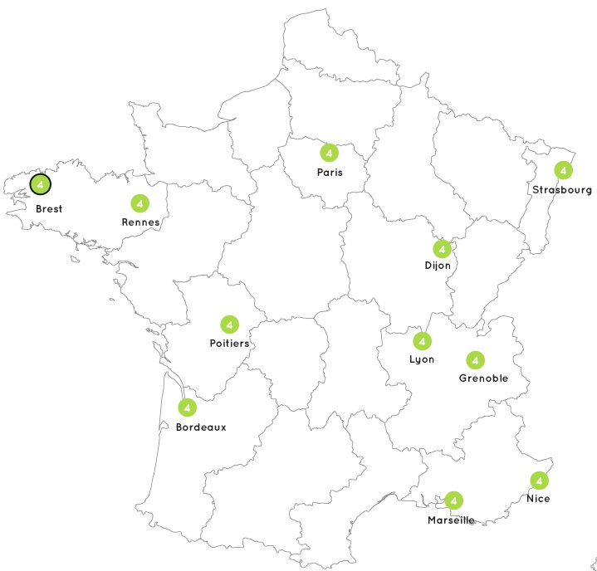
The key themes of the field comprehensively covered
Quantitative multimodality image analysis
Multi-dimensional Image Reconstruction
Exploitation of multimodality images
Database generation, data mining and knowledge modeling
Numerical simulations
Signal processing in MEG/EEG medical imaging

Slide 9

An ambitious training initiative harnessing the network expertise
Main goals
Ensure a high level education in the field of biomedical imaging, for both students and professionals, within and beyond the FLI consortium
Ensure the sustainability, professionalism and recognition of the FLI trainings in Europe
Main results (as of 07/2016)
training of over 1 000 students and professionals
creation of 10 new trainings (incl. 3 sessions for the industry)
support of >20 training actions
Creation of the French Imaging Network of Young Scientists – FINYS

Slide 10
Many events to enliven the community and strengthen the network
Organisation of the 1st National in-vivo Imaging Congress (CNIV 2016, February 10-12, 2016)
Thematic conferences and workshops
Ultrasounds seminar (September 2014)
In vivo optical imaging seminar (September 2015)
Annual interventional imaging seminars
Imaging agents workshops: cardiology and metabolism (November 2014), oncology (April 2015), neurosciences (November 2015), infection and inflammation (May 2016)

Slide 11





A deep involvement in clinical and translational research
Positioning within the clinical research continuum
Phase 0/1 studies
Advanced methodology for diagnosis and therapeutic follow-up
First-in-man studies
transfer to hospital clinical research
Multicenter studies
Cohorts
Clinical research with standard imaging techniques
Clinical research with advanced imaging techniques
Methodology developments in biomedical imaging
Preclinical research

Slide 12
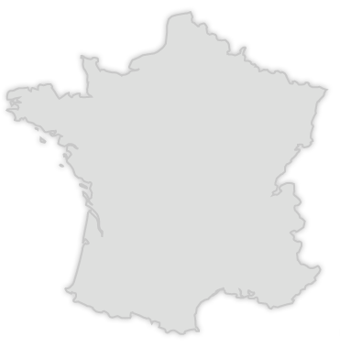
A strong expertise on specific therapeutic areas
Neurology and neurosciences
Neurodegenerative disorders
Cognitive neurosciences
Stroke
Neurosurgery
Neuro-oncology

Slide 13
A strong expertise on specific therapeutic areas
Oncology
Therapeutic ultrasounds
Tumor targeting
Tumor characterisation
Assisted surgery

Slide 14
A strong expertise on specific therapeutic areas
Cardiology and metabolism
Cardiovascular disorders
Cardioprotection
Rythmology
Atherosclerosis
Metabolism

Slide 15
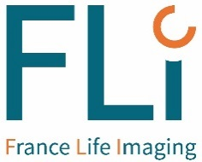
An easy access to the French resources and expertise of the biomedical imaging field
A privileged entry point to help you build
the most relevant answer to your needs
R&D services Training
Collaboration Expertise
Your needs
FLI
Thematic networks
Our offer
Laboratories
Facilities

Slide 16
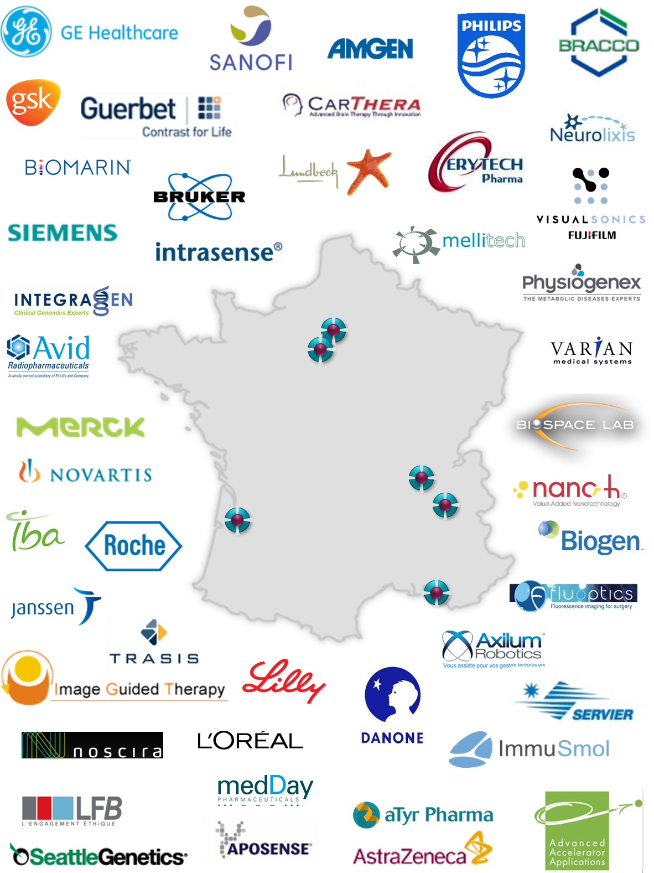
An expert contact point for collaborative research
Projects built in close relation with the teams running the core facilities
A flexible partnering strategy
fee for research service,
framework service agreement,
collaborative programs, etc.
Quality management
Many industrial partnerships hosted within the FLI facilities

Slide 17
A tailor-made training offer
Motto: help you build the best option with regards to your specific needs, expectations, goals and potential attendees
Strengths and assets:
Tailor-made trainings (eg. Molecular imaging, US Imaging, fMRI, etc.)
Responsiveness, administrative monitoring and adaptability
Training in situ, within the FLI core facilities and labs, that allows the attendees to benefit from the expertise of the researchers and staff
Official recognition: certificates provided e.g. by the INSTN–ISO9001, ECTS awarded
Strong links with the French and European Societies

Slide 18














Significant FLI case-studies
Force (Horizon 2020)
Imaging the interstitial pressure and solid forces within tumors and environment at different deformation states to assess treatment efficacy and to modulate treatment via mechanotransduction. http://cordis.europa.eu/project/rcn/199748_en.html
Imova
Research of new molecules and software for the detection of plaques in the aorta
Bioimage-NMD (FP7-Health)
Development of imaging technology to monitor response to novel therapies in neuromuscular diseases (NMD)
http://bioimage-nmd.eu/
http://cordis.europa.eu/project/rcn/110240_en.html
Hecam
Joint academic-industrial initiative to improve early diagnosis and treatment of hepatocellular carcinoma
Biomarker of CNS functional circuitry
optimization of posology for a pharmaceutical company
Study 1: 2009-2012
Effect of a drug candidate on regional brain activation assessed by functional magnetic resonance imaging (fMRI) during cognitive tasks. A double-blind, placebo-controlled cross-over randomised study in elderly healthy male volunteers.
Study 2: 2012-2014
Effect of a drug candidate on Default Mode Network functional connectivity assessed by fMRI in resting state and during cognitive task. A double-blind, placebo-controlled cross-over randomised study in elderly healthy female volunteers.

Slide 19





Showcase project: IMABio3 study
Goal: Investigate the role of neuroinflammation on the early stage of Alzheimer’s Disease (AD) and on its progression
Results
PET imaging with [18F]DPA-714 is a valuable innovative tool for accurately assessing neuroinflammation in early and preclinical AD
Correlation between the microglial activation and the AD clinical progression, high activation being associated with stable clinical progression, and low activation with rapid decline
Neuroinflammation appears in the early stages of AD, even at preclinical stage, and plays a protective role in its clinical progression
IMABio3 Clinical trial: https://clinicaltrials.gov/ct2/show/NCT01775696
Early and protective microglial activation in Alzheimer’s Disease. A prospective study using [18F]DPA-714 PET imaging. L Hamelin et al., Brain, 2016 Apr;139:1252-64
Perspectives
The protective role of early microglial response in AD pathogenesis fosters the clinical interest of microglial-targeted therapeutic approaches to slow or even prevent the disease progression
Inflammatory and immune anti-Aβ responses may constitute therapeutic markers for the assessment of novel anti-amyloid treatments

Slide 20
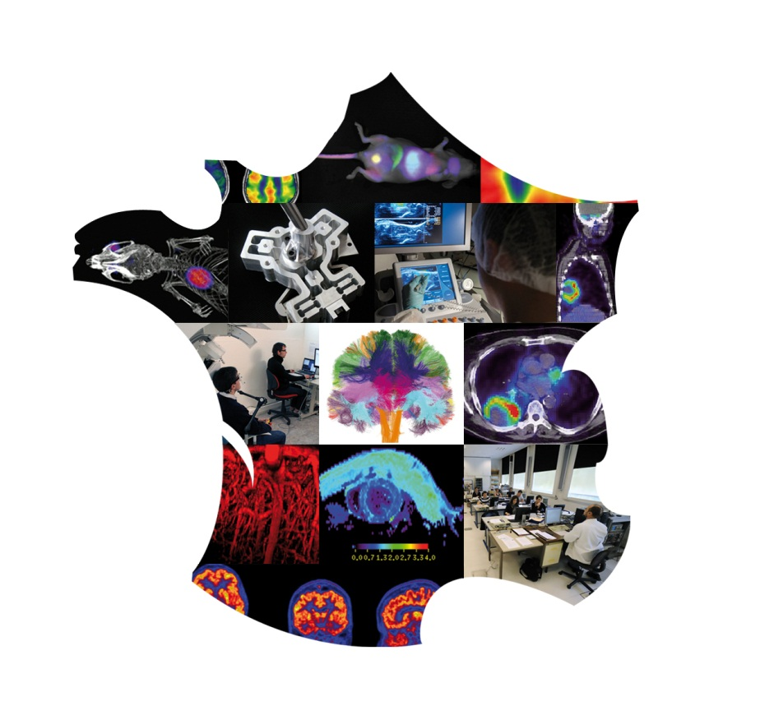
Thank you for your attention
Pierre Wiltz
Strategic marketing and business development
pierre.wiltz@cea.fr
www.francelifeimaging.fr

